Slide 1
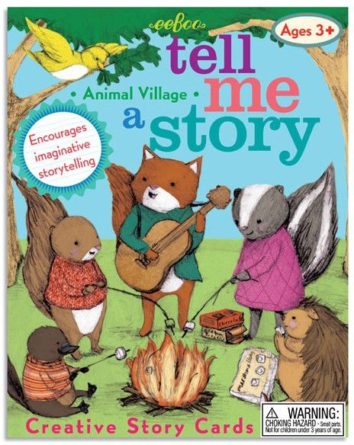
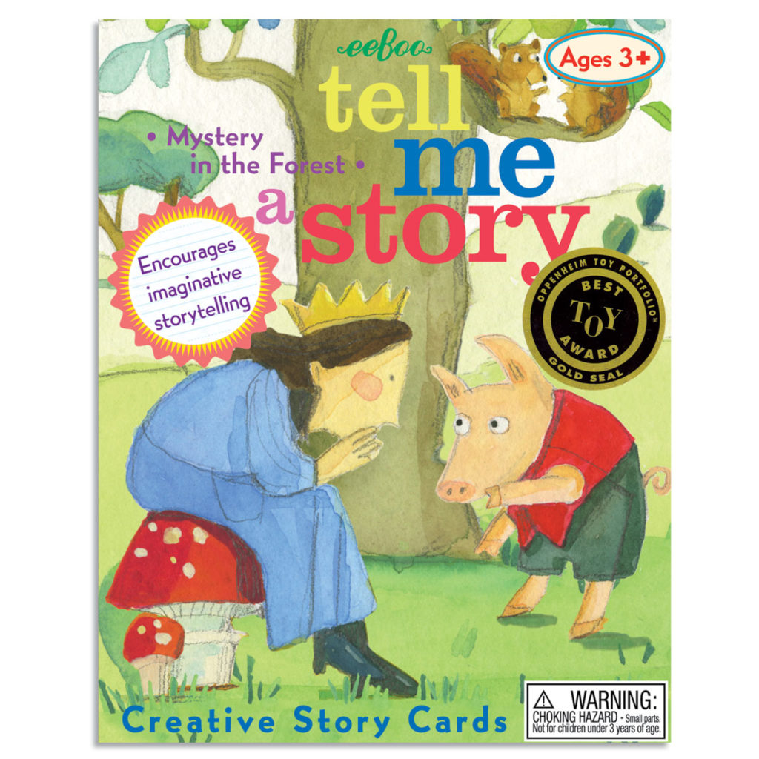
Will you read me a story? Exploring Autumn
Foundation Stage
Term 2

Slide 2
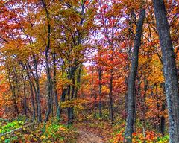
Autumn is one of the most beautiful seasons and a real period of change in the natural world. It is also a particularly exciting time for children, as distinctive sounds and smells fill the air, and the once vibrant green shades of summer give way to warm yellows, reds and browns.
In our Exploring Autumn project, your child will go on an autumnal walk around the school grounds to learn about the seasonal changes that happen in Autumn. They will learn about birds and animals that live in the woods and how they survive as the weather gets colder. They will take part in practical and creative activities that will support them to learn about autumn.

Slide 3
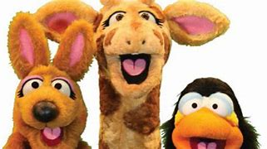
Our classroom friends.
Harold
Harold the giraffe and his friends teach us about Safety, Caring, Achievement, Resilience & Friendship.
He is very good at listening!
Fred
Fred helps us learn sounds and how to blend them.
He is very good at reading!

Slide 4
Term 2 Learning
Communication & Language.
Show and Tell is well and truly embedded now and it has been wonderful to see your children bring in such an array of objects to discuss with their friends. We have really enjoyed sharing photographs, artwork and favourite possessions.
The project ‘Will you read me a story?’ brings with it lots of new vocabulary. We will be taking the time in lessons and exploring time to explore and understand these new words. Harold the Giraffe continues to help us this term in our Personal Development lessons. This term he will be helping us to be resilient, confident learners and talkers.
We will be practising our Christmas show lines and making sure we speak clearly and confidently.
Personal, Social & Emotional Development.
The ‘Fritwell Footsteps, is making an impact on how your child behaves in school. I care for everyone, and everything is key to making a happy working environment where we look after our resources. Our children have settled down well to school life and have started to show great respect towards each other making good friendships. Next, we will be looking at how we can make sure we are making the right choices all the time. Your child’s emotional development is a priority.
Physical Development.
Last term, the Foundation Class enjoyed enhancing their PE skills including; stopping and starting, speed, direction, and listening. This term, your child will focus on gymnastics in their PE lessons. Your child will consider what it takes to be a champion gymnast as they move in high and low ways as well as over and under apparatus. The children will work on their balance, technique and presentation. Thursday PE sessions will explore movement through music and changes of tempo in our Autumn themed movement sessions. Correct letter formation and pencil grip will continue as well as writing their name independently.

Slide 5
Literacy.
This term we will be introducing Talk 4 Writing. Our writing will be focused text will be the traditional tale of ‘The Three Little Pigs’. Punctuation in a sentence will be taught looking at capital letters, finger spaces and full stops. Following the success of our Harvest Show, we know we have budding actors and singers throughout the class. We are looking forward to working with the children, acting out the story and learning the lines for our Christmas production ‘Hey Ewe’. The Reading Journals will continue to be the heartbeat of our learning alongside the continuation of Read Write Inc.
Mathematics.
Your child is now well and truly at home with completing their ‘Maths Plays’. Your child will continue the understanding of addition with 1 digit whole numbers and continue to understand one more and one less than a given number to 10. We will continue to work on identifying odd and even numbers and continue to work on subitising to 5. Counting accurately is an area that will be taught as well as counting in 2’s and 10’s. Looking at repeat patterns as well as shape, space and measure will take place. The introduction of cm’s and m’s will be introduced.
Understanding the world.
Your child will begin to understand some of the important processes and changes in the natural world around them as they explore autumnal changes. They will explore growth and decay as they examine leaves at various stages including green, brown and in a decaying state. Your child will look at different animals and sort them into groups of woodland and non-woodland. We will be visiting Warriner Farm this term where we will listen to talks and learn about the animals on the farm.
Expressive Arts & Design.
Role-play and using their imaginations will be a big part of this terms learning. To go alongside the Talk 4 Writing theme ‘The Three Little Pigs’ the children will act out the story and be creative making props. The children will explore different media such as pastel, paint, chalk and watercolours to produce Christmas artwork.
During the music sessions, your child will learn the nativity songs and combine actions and words in preparation for the show Christmas Show ‘Hey Ewe’.

Slide 6
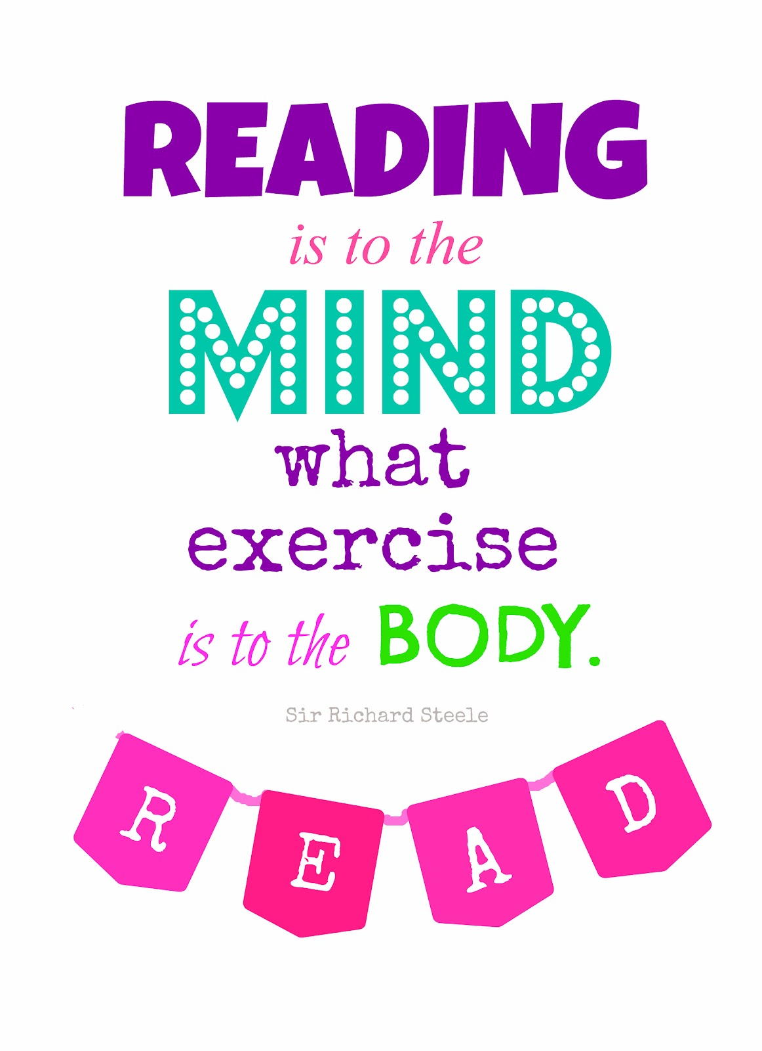
Additional Information
Forest school &P.E Days
Tuesday &Thursday
Reading
Reading Journals are looking good and it has been wonderful to see the positive reading experiences you have been sharing at home. Thank you for your continued support and efforts. Please continue to read regularly at home to consolidate the phonics sounds taught in school and to build on comprehension skills.
Please record your child’s reading in the reading journal.
Reminders
Please email / call the office with questions. Please bring coats to school every day. Can we kindly request that ALL items of clothing are named. If an item of clothing comes home that is not your child's, please bring it back to school to ensure we get it to the right owner.
Outdoor Adventures
Please ensure that your child has wellies and a wetsuit in school at all times.
*Please provide spare socks/underwear in your child’s P.E kits*

Slide 7
Useful Links
Oxford Owl
Oxford Owl is a fabulous resource for many subject areas and offers a very good reading range with many free resources.
Please follow this link: https://www.oxfordowl.co.uk/user/sign_up.html
which will allow you to create a home login with Oxford Owl. Once you have joined up and signed in, please follow this link: Free eBook library | Oxford Owl from Oxford University Press This will take you to the eBooks suitable for sharing at home.
Phonics play
A site packed with interactive phonics games which is great for child development within phonics
https://www.phonicsplay.co.uk/
Top Marks
Play these fun Maths Games for 3-5 year olds
https://www.topmarks.co.uk/maths-games/3-5-years/counting

