Slide 1
Fritwell School Newsletter
Autumn Term Friday 15th September
Dear Parents/Carers,
Welcome to the first full newsletter of this new academic year. Although it seems in the very distant past, I hope you all had a good summer!
There have been meet the teacher opportunities this week and lots of class information through various letters and communications. I hope you have all the information you need and going forward. Teachers are available at the end of the day for any questions and, Jo and I will also be on the gate during the week so if you have a question or want to stop for a chat, we are very happy to talk!
There have been a lot of exciting changes for this academic year and I hope you have got to hear about some of them through your children already. The new seating positions for lunch (sat in family groups) are working better than we ever could have expected; older children are helping the younger ones with pouring water for example, and they are doing a great job of wiping down the tables after they have eaten – you could almost eat your lunch off them!
The children have voted for the new family group names which will now be named after the oceans, and we look forward to doing lots of team-based activities during the year.
Applications for pupil leadership opportunities have been flooding in and we will be announcing the leadership groups children will be working in next week.
Monday is our new celebration assembly day and the Fritwell Footstep Award will replace the Child of the Week. Two children from each class each week will be selected for showing the specific footstep for the term in action. This term’s footstep is ‘Curiosity’ where we will be looking for children showing a thirst for knowledge! If your child has been selected, you will receive an email on a Thursday afternoon inviting you to the Monday assembly 9 – 9.30.
Wishing you all a peaceful and (hopefully) sunny weekend.
Jon Jeffries
Headteacher

Slide 2
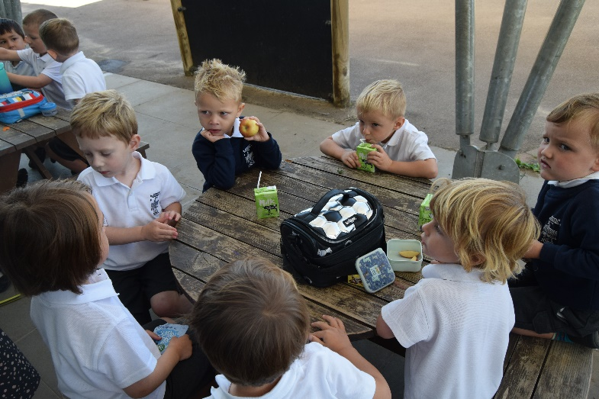
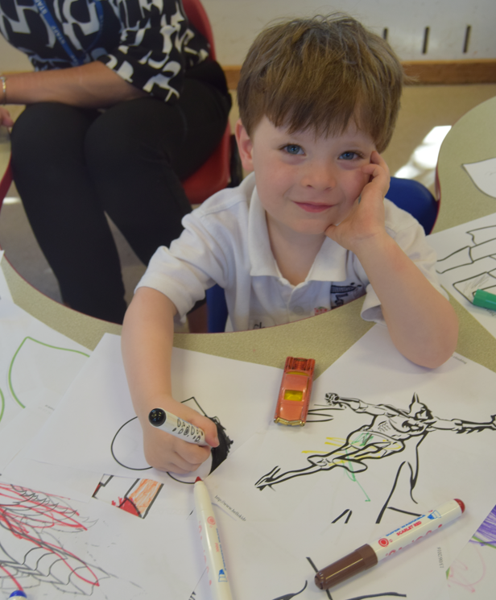
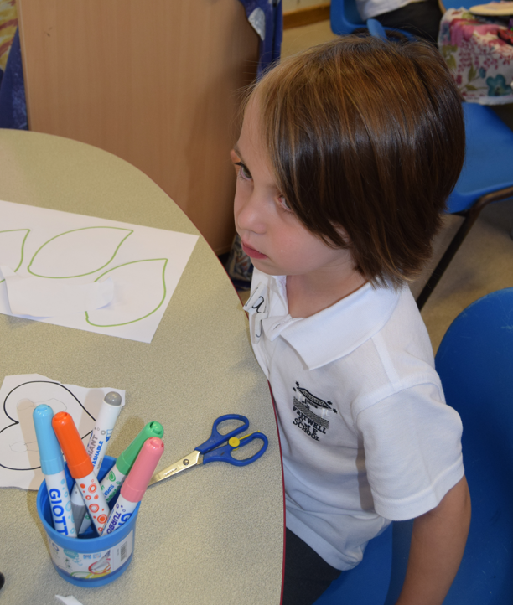
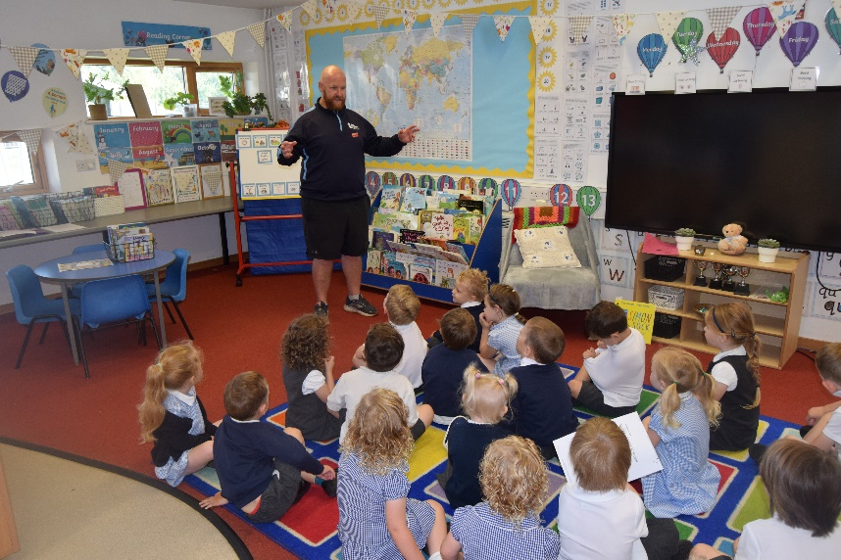
Classroom Activities
The first two weeks at Fritwell school have been full of fun packed activities, including, forest school, PE in the hall, library time and daily worship for the Minnows who have showed the Fritwell Footsteps in abundance this week. The Tiddlers in school have settled into school life with big smiles on their faces. We are looking forward to the build up to our first ‘Harvest Show’ in a few weeks’ time. The Early Years team could not be prouder of the children and their learning and one of the most impressive attributes about the classes are their fantastic manners. Well done Minnows and Tiddlers, we are very proud of you.

Slide 3
Dates for your diary
September
Tuesday 19th – Read, Write Inc talk to Reception Yr1 and Yr2
Parents 2.30pm
Wednesday 20th – School Cross Country – All classes to participate.
Wednesday 27th – Inter school cross country, The Bicester school.
(Only children selected from the results of the school event to attend)
Wednesday 27th – Flu Vaccinations. Please fill in consent forms
ASAP.
Thursday 28th – Vision Screening (Reception children only)
October
Friday 6th - Harvest assembly, 10am – detail TBC
Monday 9th – EYFS harvest performance to parents 2.30pm.
Tuesday 10th – Hello Yellow day
Friday 13th – Individual School Photos
Tuesday 31st Oct/Wednesday 1st Nov – Parents Evenings.
Fritwell Footsteps Awards
Tiddlers and Minnows – Freddi F & James N
Sticklebacks – Freddie H & Luna K
Seahorses – Elizabeth C & Brody H
Stingrays – Ruben RB & Oscar L
Sharks – Caleb B & Sebastian L
Headteacher Award – William K

Slide 4
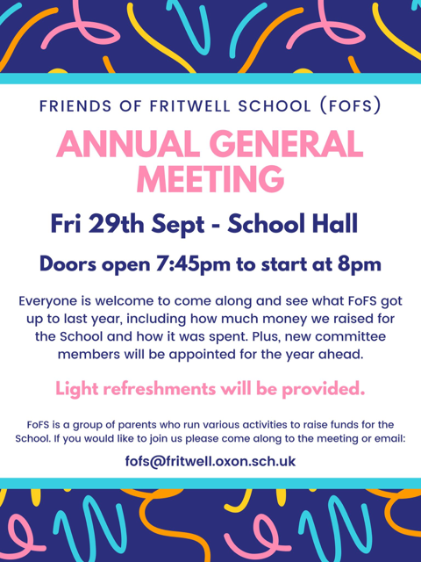
FoFS
Fofs will be Hosting a Macmillan bake sale on
Friday 29th Sept
after school in the music room.
This has always been a popular event as the children all have the opportunity to buy some sweet treats after school.
In order for this to be a success we are asking that all the children bring a contribution towards the bake sale.
This can be a whole cake, some cupcakes or cookies.
Don’t worry if you are not a baker you can always send in some shop bought cakes or cookies. All donations are very much appreciated.
All donations must arrive on the morning of the bake sale and can be placed in the Music room. They must be clearly labelled with the ingredients and if they are in a container you need back please label it with your childs name.

