Slide 1
Fritwell School Newsletter
Autumn Term 2 Friday 24th November
Dear Parents/Carers,
Welcome to this week’s newsletter. We are now over halfway through the term and so much has been achieved. We have been assessing the children with standardised tests and the results of these will inform our teaching and provision for the rest of this term and next term. Mrs Churchill has been working incredibly hard on setting up these new systems which will enable us to be very specific in what we do. Once these results are collated, Mrs Ejiogu and I will be having pupil progress meetings with all the teachers where we discuss every individual child to ensure they are getting the exact provision they need. I continue to show prospective parents around the school and without exception, they comment on how well behaved and hard working the children are. Thank you families, as always, for all the support you give us in making sure your children come to school ready to learn.
Actions from our Pupil Leadership Groups are really starting to take off. My Climate and Environment Group this week started their campaign to switch off lights and close doors. A lot of energy is lost through lights being on in classrooms when everyone is out at break and lunch. When outside doors are open you can literally see the heat (and money!) pouring out. Jack, Sanvid, Jude, Emily and Jacob have made posters, announced what they are doing in celebration worship and will be visiting classes every break and lunch with their clipboard. The class (or office staff) who have been most energy conscious during the week will be announced each week on a Monday and be presented with a trophy. Not that we are competitive at all, but let battle commence!
The Gardening Leadership Group, led by Mrs Ejiogu, will this weekend be planting spring bulbs at the four gates to the village, on behalf of the parish council. Thank you to all the families who have volunteered to be involved in this. We look forward to spring when we can all enjoy your efforts.
Miss O’Brien leads our Charity Leadership Group who have been busy researching potential charities. The next stage is to make a presentation to share with the school, and children will then be able to make an informed choice for their vote. We will have further leadership updates next week.
This week, Key Stage 1 children went to a multi-skills event at Heyford Park which they thoroughly enjoyed. It was great to see them coming back with huge smiles on their faces after trying activities like fireman’s ladders, bowling and hockey dribble. Next Thursday year 3 boys will also be going to Heyford Park to take part in a sports festival, and the following Thursday it will be the turn of the year 3 girls. Here they will be able to try a range of sports which aims to develop their confidence in a range of physical activities and skills. All of these events take a huge amount of organisation so a big thank you to Miss O’Brian and Mrs Churchill.
Rehearsals are well under way for the nativity plays and the excitement from the children (and staff) is palpable. I have heard how committed some families have already been with learning lines, so I am sure this is going to be a fantastic way for us to celebrate the festive season!
Wishing you all a peaceful weekend,
Jon Jeffries
Executive Headteacher

Slide 2
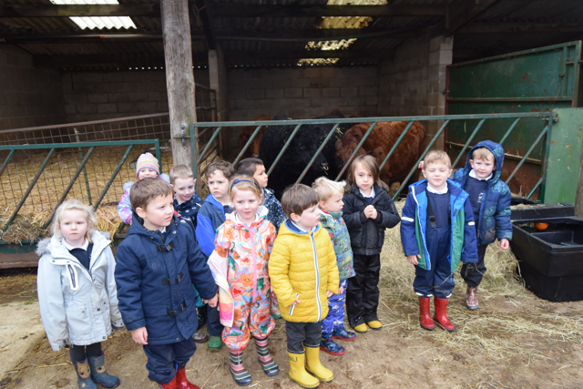
Classroom Activities
Tiddlers & Minnows
Autumn Term 2 is passing by very quickly. The children have been working very hard and ‘Fred’ has been very proud of the children’s writing and being able to Fred Talk CVC word. The class have been taking part in a new maths programme called ‘Mastery Maths’. All the children are taking part in the visual activities and loving their learning. The Minnows showed the 'Fritwell Footsteps' on their first trip of their Reception Year. Maria at the farm, was very impressed with the children's 'Knowledge and Understanding of the World' answering questions about hay, straw and what meat we get from different animals. Forest school is as exciting as always and the children have showed great progress in their team work skills. Lastly, the ‘Christmas Show Show’ is coming together beautifully. The children are learning the songs and their lines incredibly well. The Early Years Team would like to thank you for your continued support this term and working as a great partnership together.

Slide 3
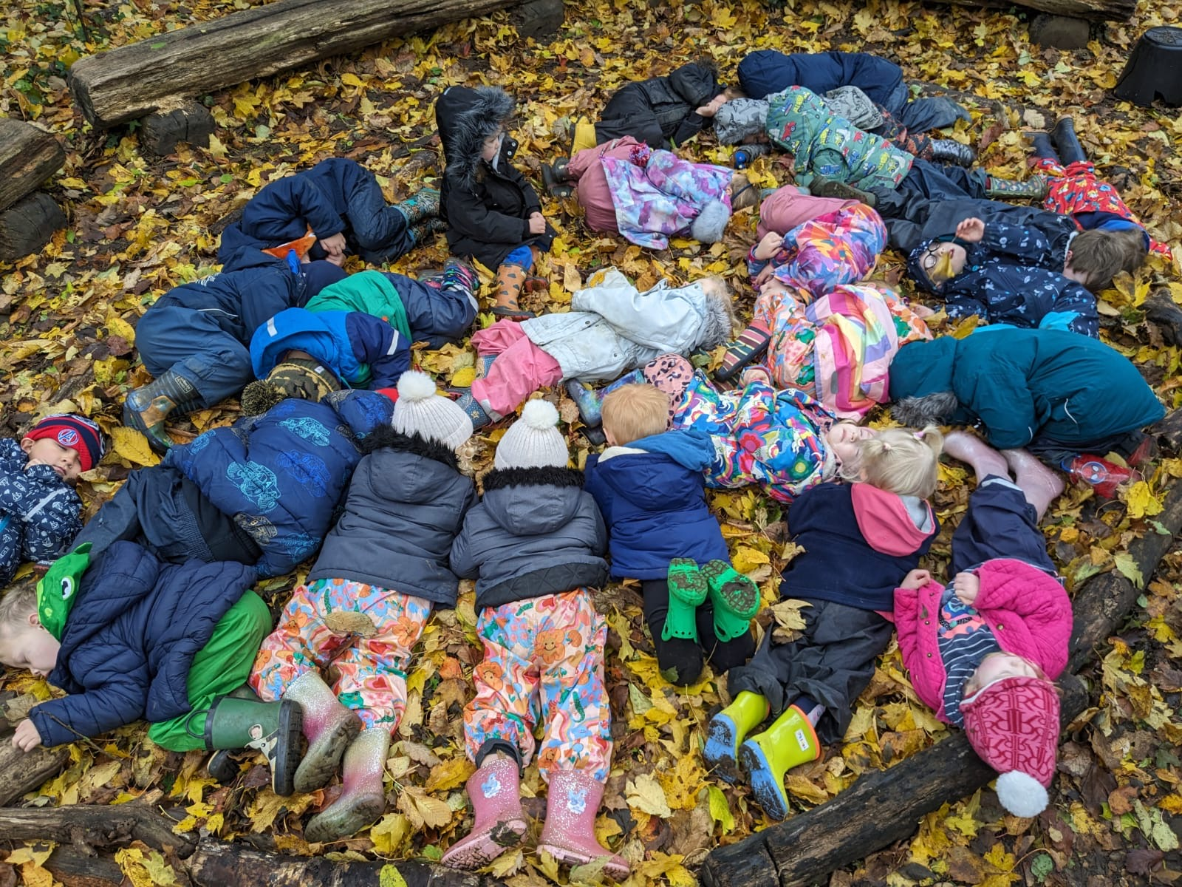
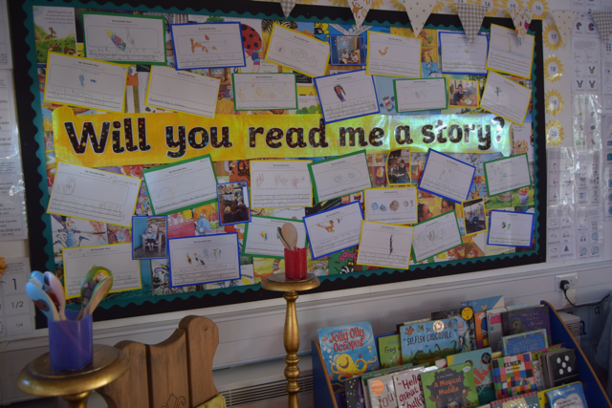
Classroom Activities

Slide 4
Dates for your diary
November
Wednesday 29th – Lower school trip to the pantomime
Thursday 30th – Boys Festival Y3
December
Friday 1st – Upper School trip to the pantomime
Tuesday 5th – Santa Fun Run
Thursday 7th – Y3 Girls Festival
Friday 8th – Christmas jumper day/decorating day
Friday 8th – EYFS Nativity to parents 2pm.
Wednesday 13th – Stingrays Community Tea Party (time TBC)
Wednesday 13th KS1 Nativity to parents 10am
Thursday 14th – KS1 Nativity to parents 2pm
Friday 15th – Secret Present room
Tuesday 19th – Christmas dinner
Wednesday 20th – Christmas service at St Olaves, led by Sharks
January
Monday 8th – Inset Day
Tuesday 9th – Back to school
Fritwell Footsteps Awards
Tiddlers and Minnows – Harry G & Rory B
Sticklebacks – Ava C & Lily S
Seahorses – Harrison H & Reid C
Stingrays – Darla C & Louise F
Sharks – Daniel D & Harriet CM
Headteacher Award – Phoenix S

Slide 5
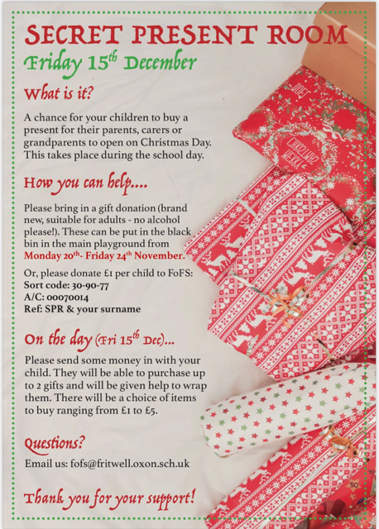
FoFs
Fireworks.
This year’s Fritwell Fireworks raised… £1,600 for our school!!⭐️ Thanks again to the fabulous FoFS team, all the volunteers, suppliers, donators and all of you lovely lot for coming along to support this much loved school event!

