Slide 1
Fritwell School Newsletter
Autumn Term Friday 29th September
Dear Parents/Carers,
It has been a really busy couple of weeks with everybody now firmly settled into the new academic year. Highlights include the whole school cross country with the top four children from each year group going on to represent us at an inter-schools competition at Bicester School. The children showed amazing resilience and determination and did Fritwell proud!
Seahorses class had a Stone Age day to support their topic learning this week. We had a visitor from the Oxfordshire Museum Service who brought with them artefacts that the children could handle and inspect. The children threw themselves into drama activities and carved arrow heads out of soap. The children had a brilliant time and it was great their topic could be brought to life in this way
The team have been busy around the outside area of Minnows and Tiddlers making it ever more inviting and fun for the children. We now have fresh topsoil, bark and plants which coupled with new resources inside the classroom (thank you for all the donations so far!), makes our EYFS a truly fantastic place to be.
This week, each class had a live session with the virtual Life Bus which helps promote mental health and wellbeing. The theme for the session focussed on relationships and how to react in different situations. We met Harrold the Giraffe who helped guide the children through different scenarios. It was very informative and a lot of fun.
FoFS (Friends of Fritwell School) are having the AGM on Friday 29th September at 8pm in the school hall. Numbers have dwindled over the years so it would be great to see some new faces! FoFS raise a significant amount of money for the school which goes towards subsidising the cost of trips and paying for the Christmas panto, for example. Any help you can give would be greatly appreciated.
On Thursday and Friday we welcomed a photographer, Laila Pipara, who came to capture the spirit of the school. We want to update photographs on the website and also produce a prospectus which helps us showcase all that Fritwell school has to offer. Laila did an excellent job and we can’t wait to share the results with you. The children were on top form being their normal brilliant selves!
On 7th November, we are having an open day for prospective reception children for the Sept ’24 intake. If you have friends in the surrounding villages who are looking for a school place, please let them know about the open day. Prospective parents can also contact the school office for a tour of the school at any time.
Wishing you all a peaceful weekend.
Jon Jeffries

Slide 2
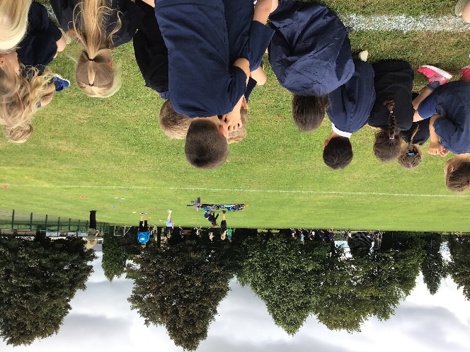
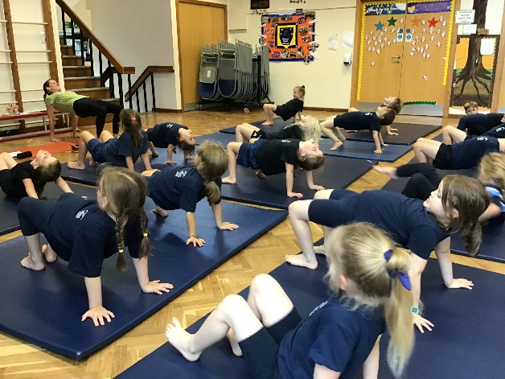
Classroom Activities
Sticklebacks
Sticklebacks have enjoyed the start back to school this term and it has already been a busy few weeks! We have kicked the new school year with lots of activity. We have enjoyed taking part in the cross-country event in school, where we ran 2 whole laps of the field. When we weren’t running we were showing a good team spirit by cheering on those who were running. Sticklebacks have also enjoyed taking part in yoga every week. This week we have learnt a sun dance that included lots of yoga poses.
One of our favourite lessons inside the classroom has been topic; our topic this term is Fire and Ice. We have begun by exploring the Gunpowder plot and the Great Fire of London. The children have asked lots of excellent questions and made some great comparisons to how it is different to today.

Slide 3
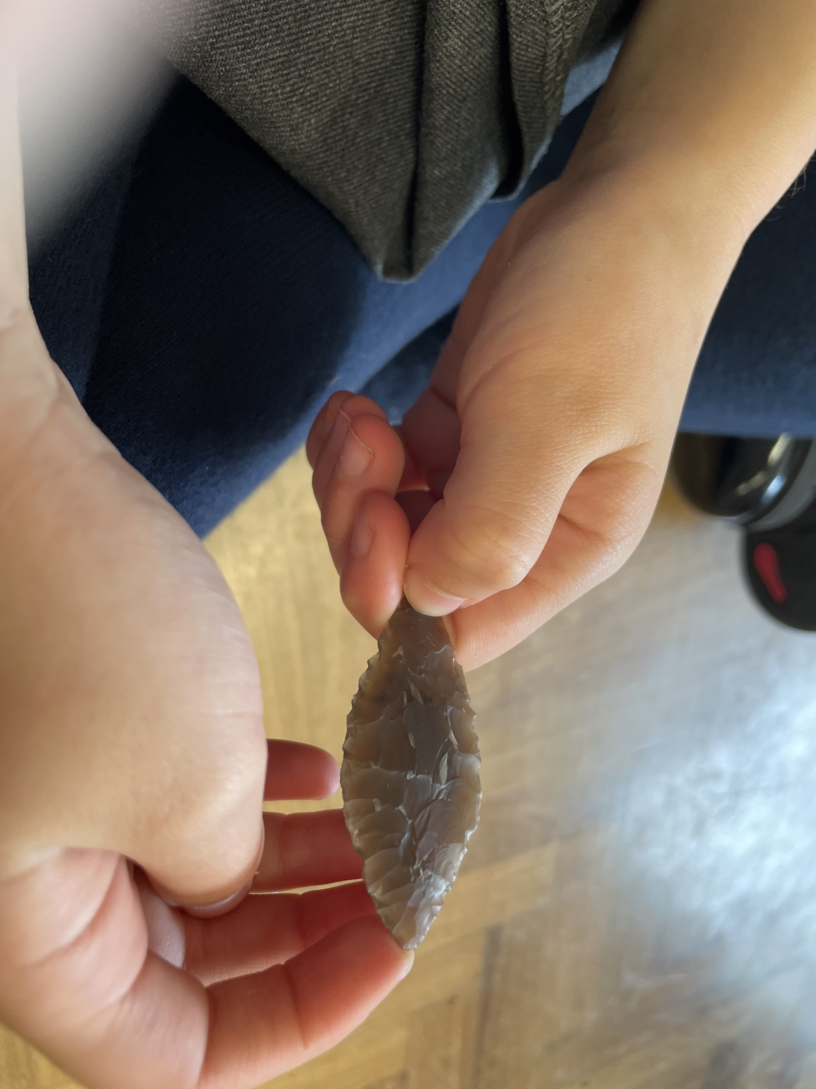
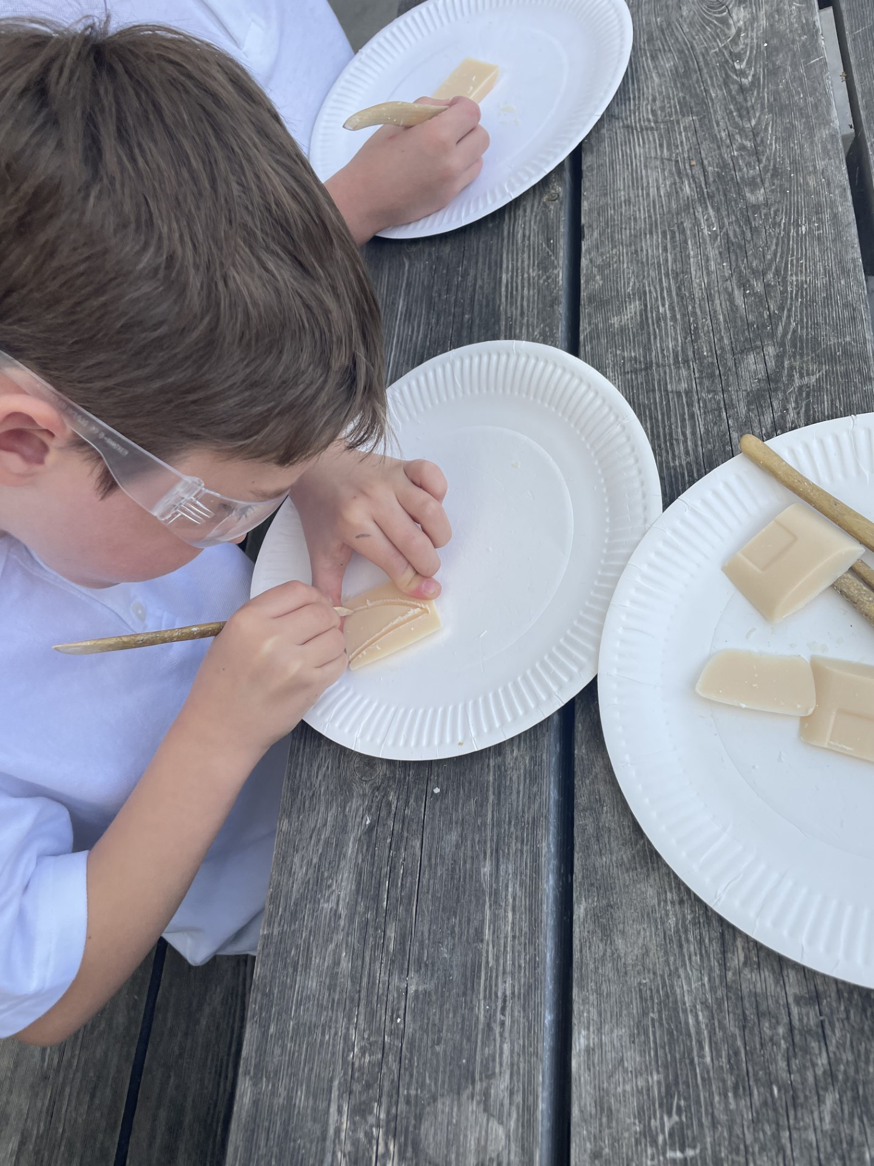
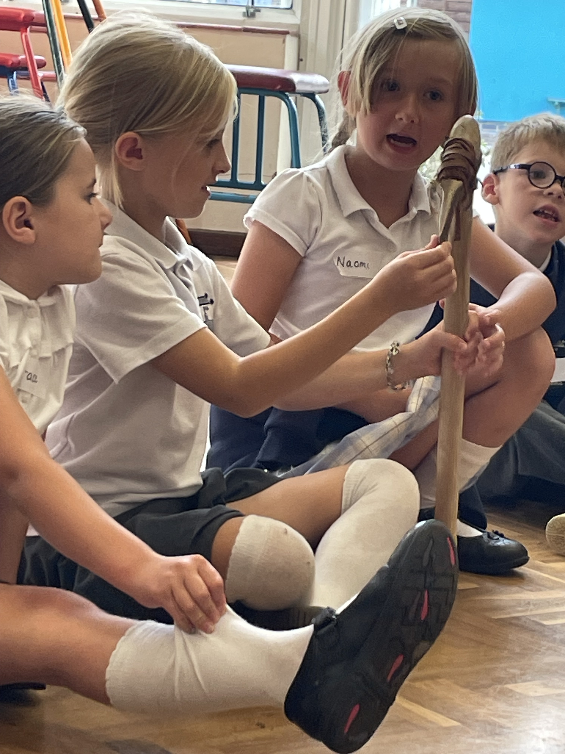
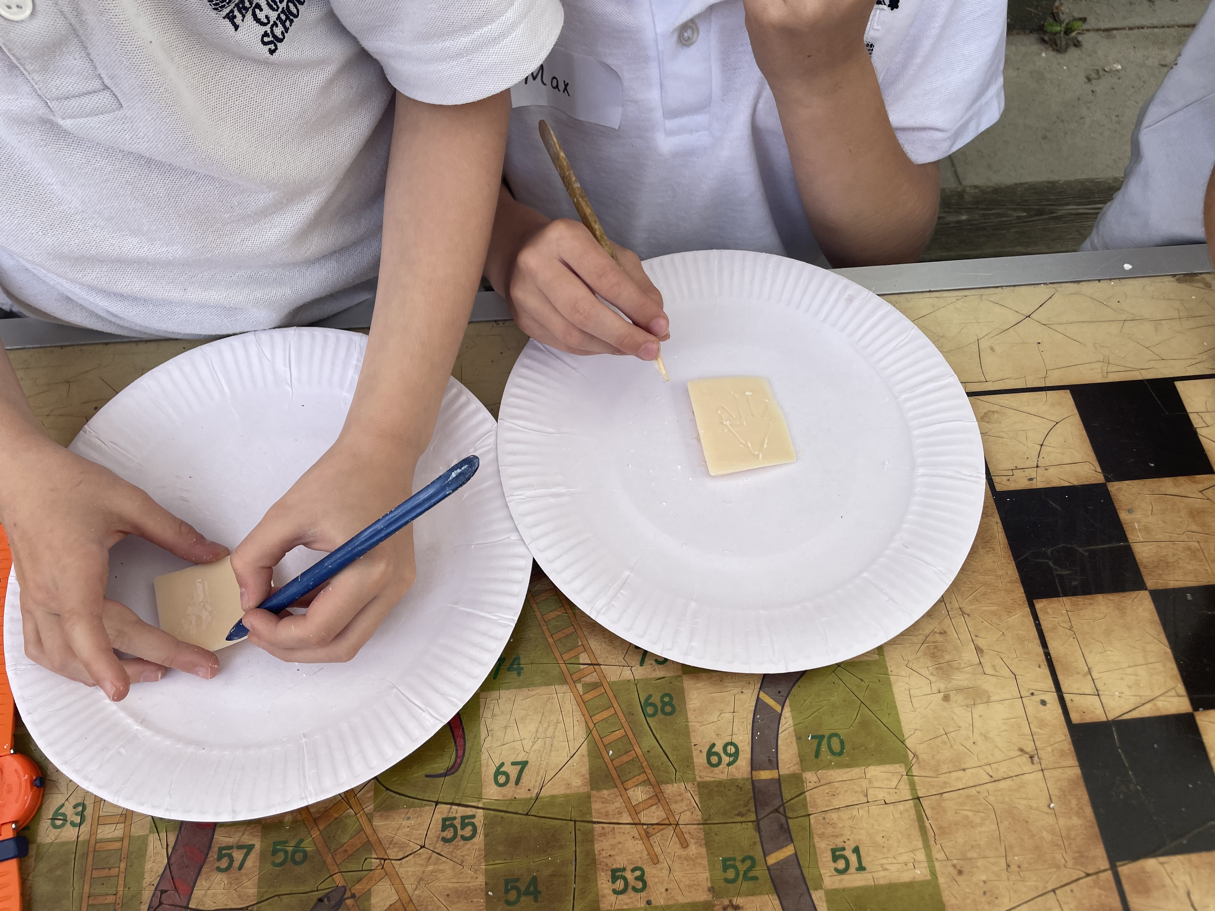
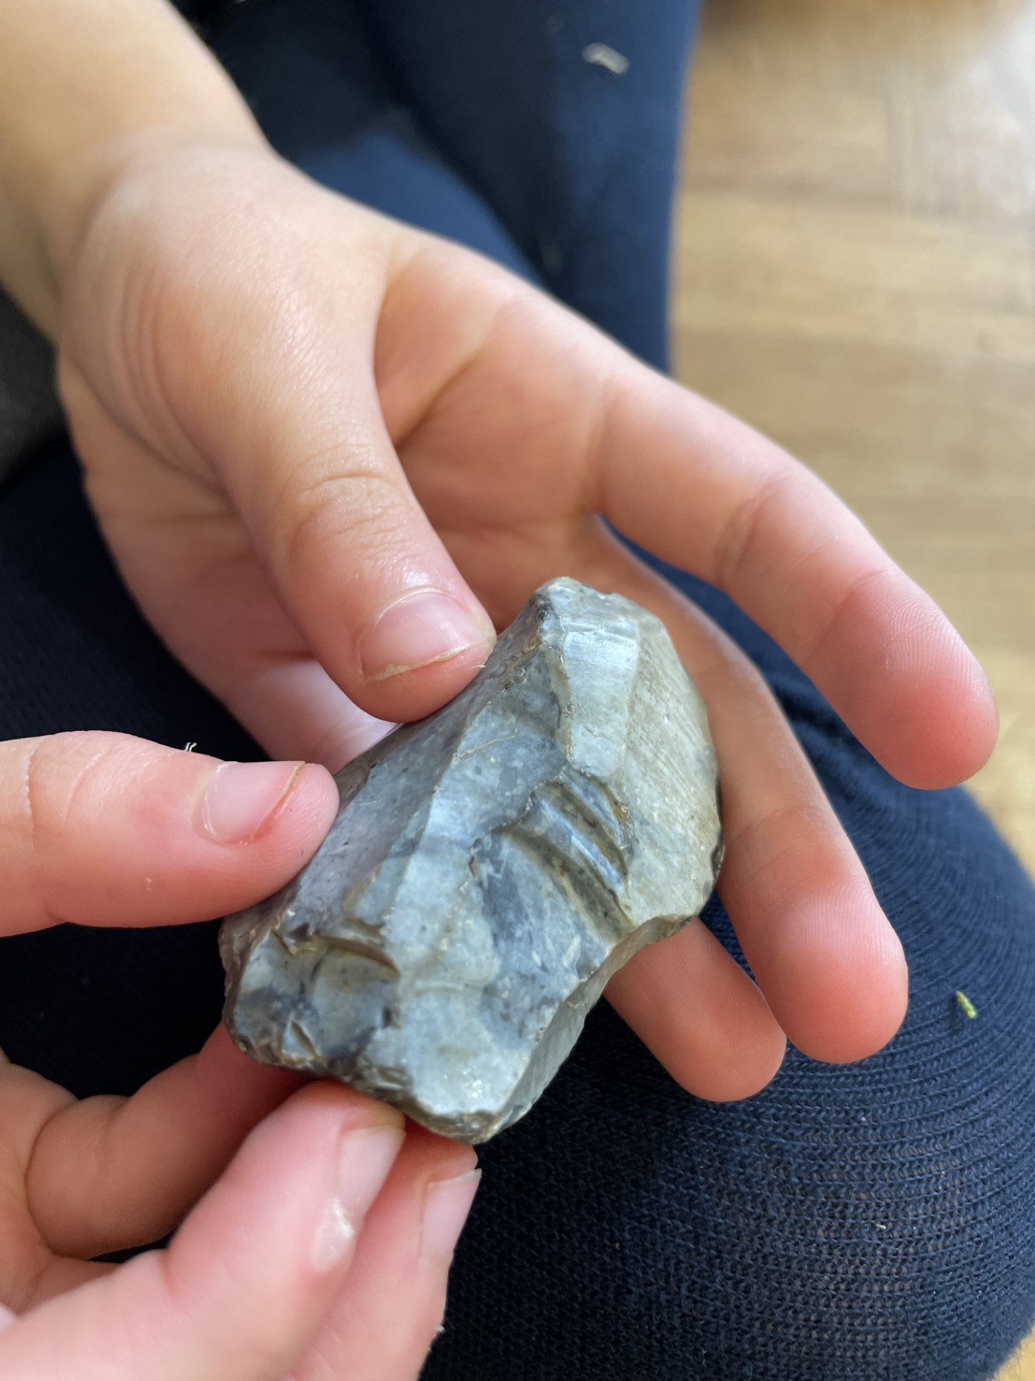
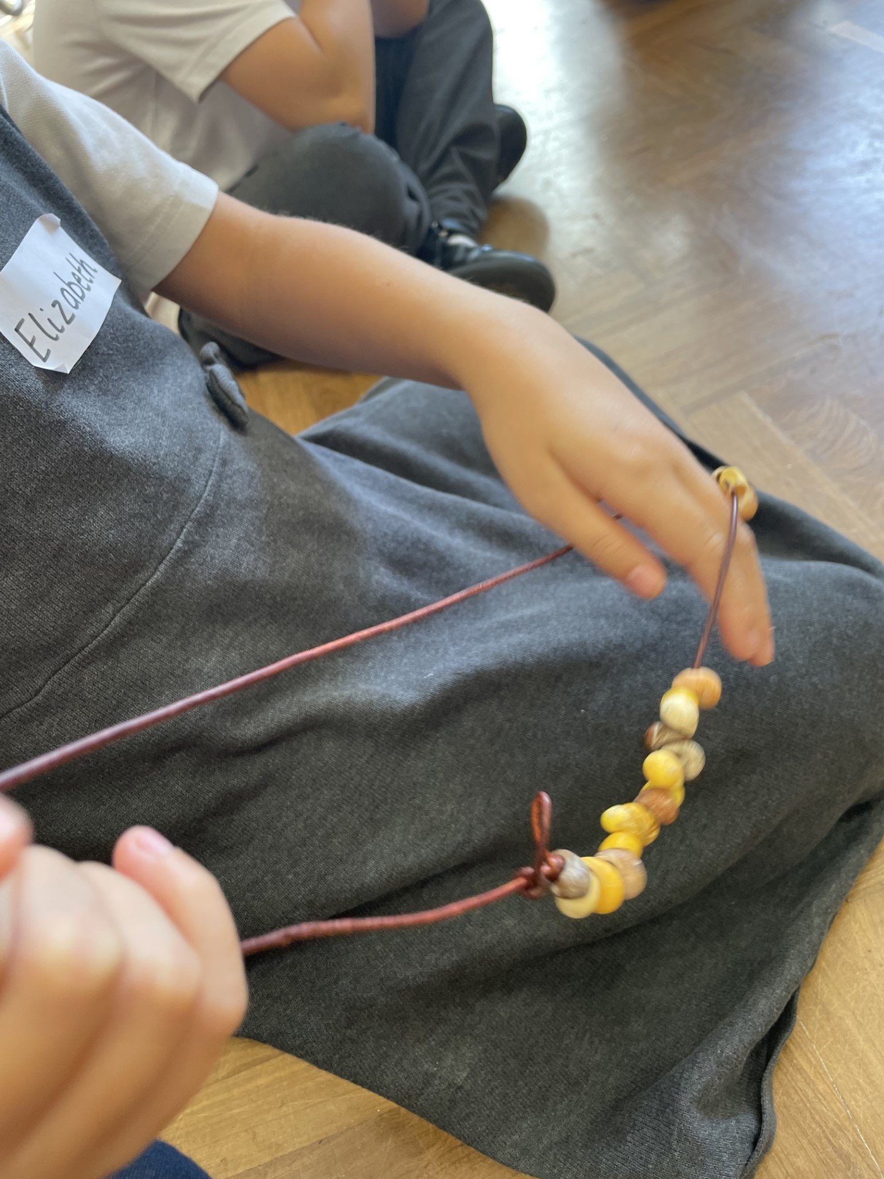
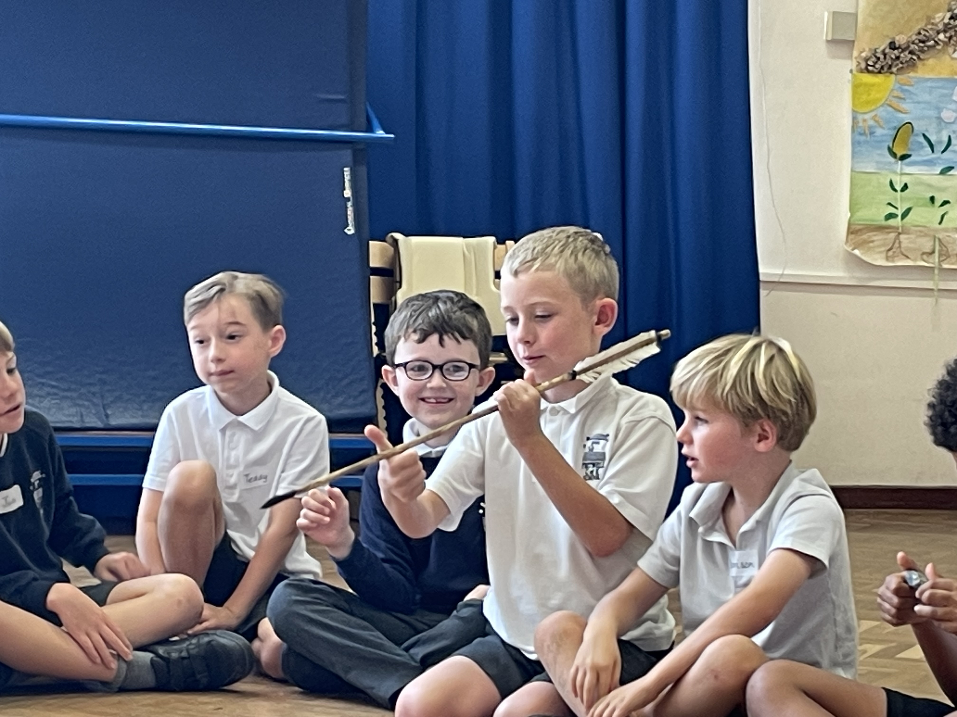
Classroom Activities
Seahorses
Seahorses go all Rock and Roll!
Seahorses were greeted with a new Seahorse this term to kickstart the new school year. Elvis is back in the building! We named him after the King of Rock and Roll as we learnt about his life in the first week. He is going to be our class Seahorse buddy and we are determined to find out as much as we can about the Rock and Roll legend as well.
We were also thrown into our topic of the Stone Age with a bit of a rocktastic time in Science in which we used our curiosity to group and sort some rock samples. We have since furthered this by learning about permeability, durability and other fantastic features in our rocks. The class smelt strongly of vinegar after our testing!
Not only have we fitted in a visit from Harold the giraffe in our LifeBus sessions, in which he helped us think of ways to help our well-being, but we have also been lucky enough to welcome Sonja in with her Stone Age tools. Our photos do not give enough credit to this fabulous afternoon in which we finished off by creating our own arrowhead out of soap (stone would be too much Health and Safety.)
Next week we will be delivering the Harvest Service in Church so, no rest for these Seahorse Stone Age Superstars!

Slide 4
Dates for your diary
October
Friday 6th - Harvest assembly, 10am – detail TBC
Monday 9th – EYFS harvest performance to parents 2.30pm.
Tuesday 10th – Hello Yellow day
Friday 13th – Individual School Photos
Tuesday 31st Oct/Wednesday 1st Nov – Parents Evenings.
Fritwell Footsteps Awards
Tiddlers and Minnows – Alana W & Hugo M
Sticklebacks – Isabel P & Edward VH
Seahorses – Samuel C & Max M
Stingrays – George H & Vanessa S
Sharks – Zoe W & Chloe D
Headteacher Award – Mason CM
#HelloYellow
Tuesday 10th Oct
Dig out your neon socks, custard scarf and banana hat - let's stand out and show up for young people's mental health.
We can all struggle with how we’re feeling, but sometimes things get tough and it can be difficult to cope. For so many young people, when this happens, they don’t get the help they need, when they need it.
No young person should feel alone with their mental health.
But together, we can change this. By wearing yellow on World Mental Health Day (10 October), and donating what you can, you can show young people that you’re with them. Show them that they matter and deserve the support they need, when they need it, no matter what.
We are joining thousands of individuals, schools and communities across the country to stand out and show up for young people’s mental health this #HelloYellow.
This small act can make a big difference for millions of young people across the country.
We are asking that you send your children to school on Tuesday 10th wearing yellow and pay a £1 donation via Parent pay

Slide 5
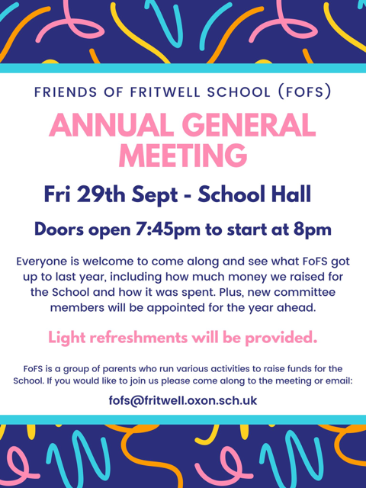
FoFS
Please come along if you can, it would be great to see some new faces.

