Slide 1
Fritwell School Newsletter
Autumn Term 2 Friday 10th November
Dear Parents/Carers,
This term marks the beginning of a new chapter at Fritwell CE Primary School. On 1st November, the school received documentation from the DfE officially confirming our joining with Eynsham Partnership Academy. This is the culmination of many months work by school governors, Val and Cary in the office, and EPA staff so a huge thank you to all who have been involved.
Joining EPA brings many advantages and opportunities. Bartholomew Secondary School in Eynsham and Heyford Park School both do Mandarin as an option in year 7. EPA primary schools currently teach this in KS2 so from today year 6 will also be receiving Mandarin lessons from a native speaker. Whether Heyford Park is a secondary choice or not, it is great experience and exposure to a non-European language.
Another EPA opportunity is that we are advertising for a chaplain to work across all EPA schools. We will have half a day a week of support which could include leading collective worship, working on projects with the children like a prayer space at church, and developing our vision and values further. This has also been a good time to reestablish our relationship with the church, where we have agreed that Revd Helen Barnes will organise and lead festival worship held at the church. This will involve Stingrays assisting the service at Christmas, Seahorses at Harvest, Sticklebacks at Easter, and Sharks for the leavers service in July.
On Sunday we had the fantastic fireworks display. A huge thank you to FOFS for the organisation and giving up time on the day to run the stalls. Everyone had a great time and I can’t wait to hear how much money was raised! Some of this money will be going towards furnishing a new sensory room as part of our ELSA support (Emotional Literacy Support Assistant). This is something that Mrs Lyons will be leading on, and we will keep you updated on how this goes.
On Tuesday we welcomed prospective parents to Fritwell for our open afternoon. All the parents I spoke to were extremely complementary about the children’s behaviour, manners, and general welcoming atmosphere of the school. It was really pleasing to hear a number of the parents attended because of recommendations from parents of children at Fritwell. Thank you!
I hope you all have a peaceful weekend,
Jon Jeffries
Executive Headteacher

Slide 2
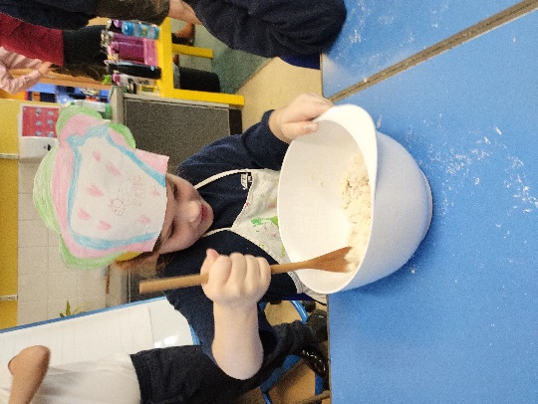
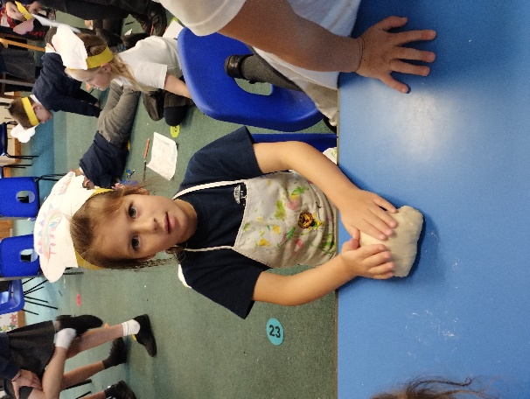
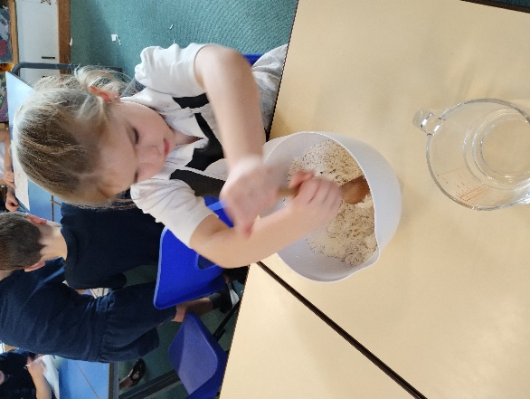
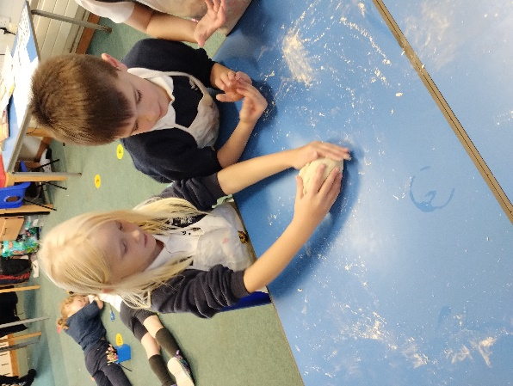
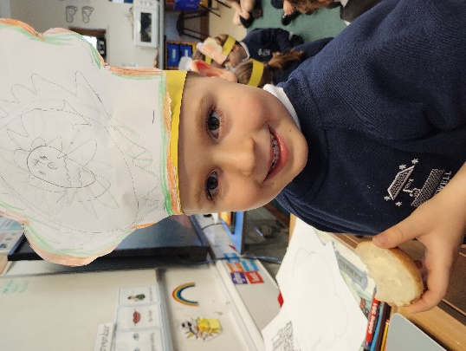
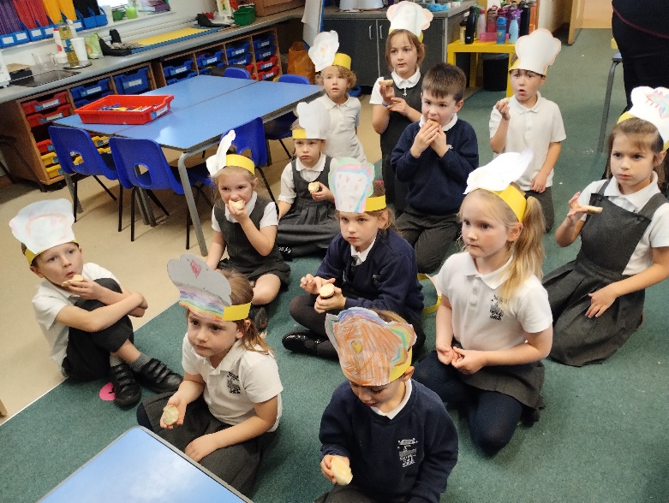
Classroom Activities
Sticklebacks
Sticklebacks have already had a busy term, although we have only been back 2 weeks. Last week we enjoyed a science experiment, exploring sinking and floating and had lots of surprises. Some surprises included paper holding the weight of a conker and a plastic bag floating for longer than we expected.
After learning about the Great Fire of London starting in a bakery, Sticklebacks were inspired to make their own bread rolls and bakers hat. They felt like true bakers with their personally designed hats. The children loved every minute of cooking and were able to share their final products together in class. Many said the smells wafted through the school and they wanted to come and join the fun.

Slide 3
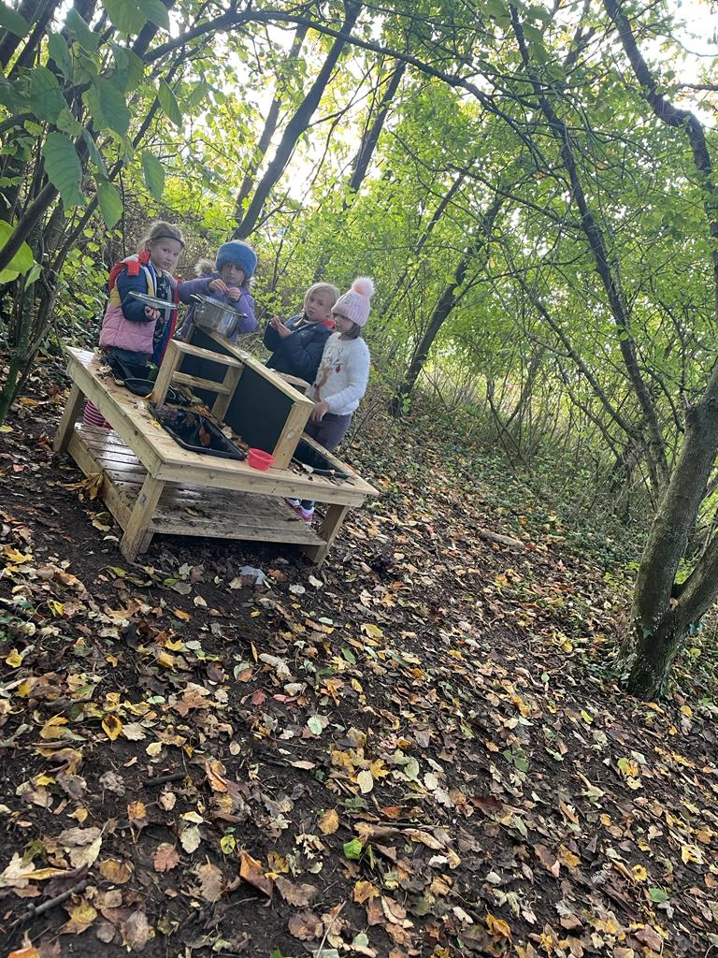
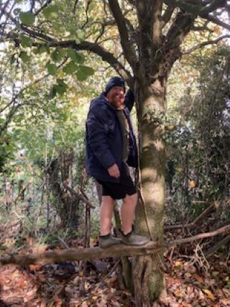
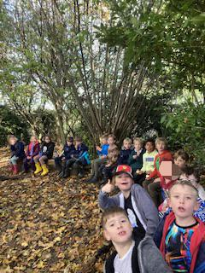
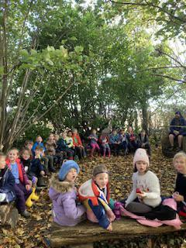
Classroom Activities
Seahorses
Another week has just flown by in Seahorses and we remain as busy as ever learning new skills and trying our hardest with our Footstep of Concentration this term.
There were plenty of opportunities for Personal Success with Humility in Forest School, when Mr Pemble gave more control to the children with their warm-up game. They were able to sort themselves into teams and agree on an animal that would be an ideal predator. Well done Seahorses.
On Tuesday, we started to think about Remembrance Day and read the story of "Peace Lily". We have started to create our own poppies and brooches to show our respect and compassion for the armed forces.
Nativity fever has begun and we are busy preparing our songs and performance for you all in December. There are many talented shepherds, crackers and mince pies to be seen and we are all excited about this.

Slide 4
Dates for your diary
November
Thursday 16th – Minnows trip to Warriner Farm
Friday 17th – Children in Need
Thursday 23rd – Multi skills festival KS1
Wednesday 29th – Lower school trip to the pantomime
Thursday 30th – Boys Festival Y3
December
Friday 1st – Upper School trip to the pantomime
Tuesday 5th – Santa Fun Run
Thursday 7th – Y3 Girls Festival
Friday 8th – Christmas jumper day/decorating day
Friday 8th – EYFS Nativity to parents 2pm.
Wednesday 13th – Stingrays Community Tea Party (time TBC)
Wednesday 13th KS1 Nativity to parents 10am
Thursday 14th – KS1 Nativity to parents 2pm
Friday 15th – Secret Present room
Tuesday 19th – Christmas dinner
Wednesday 20th – Christmas service at St Olaves, led by Sharks
Fritwell Footsteps Awards
Tiddlers and
Minnows –
Seahorses –
Stingrays –
Sharks –
Headteacher Award –
Whole school trip to the pantomime.
As you know we are going to see Cinderella at Chipping Norton Theatre. This year, the Performance of Cinderella, takes us to the heat and colour of Latin America. Columbian Hanging Lanterns will adorn the auditorium and we are planning to take our own lantern with us.
In order to do this we need each child
(Minnows-Sharks) to bring in an empty clear water
Bottle to make their own lantern.

Slide 5
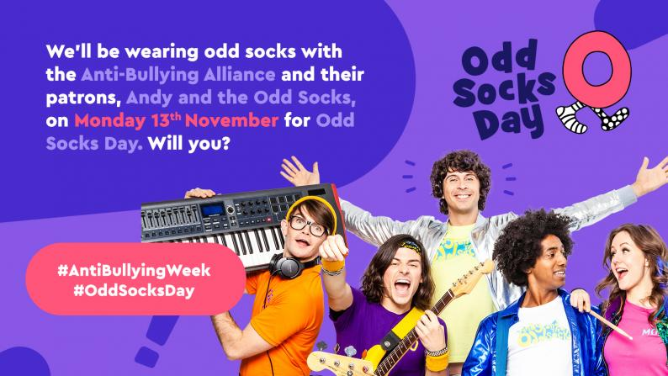
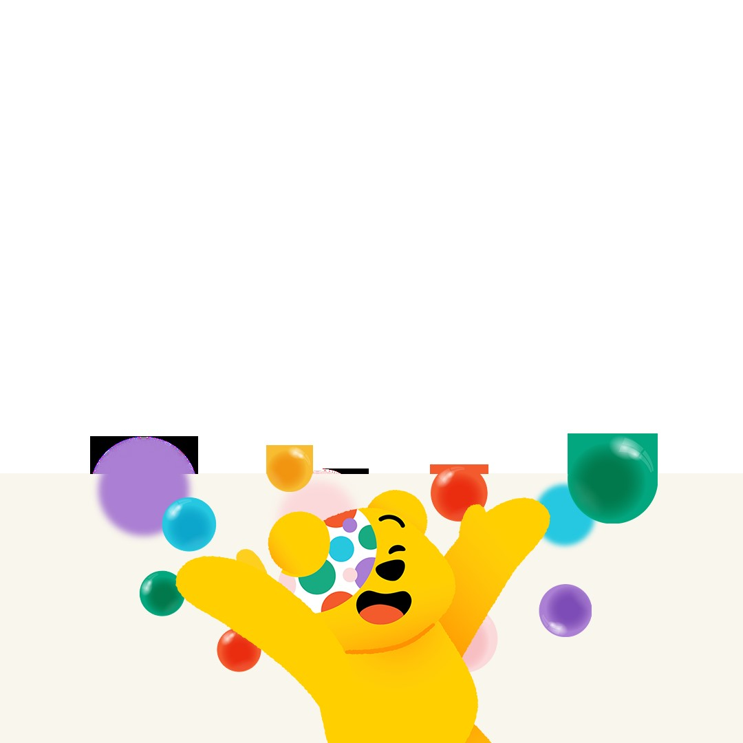
Odd Sock Day
Monday 13th November is Odd Sock Day, Raising awareness for Anti Bullying week.
Find your brightest socks!
Children in Need
We are supporting children in need this year by wearing something spottily Spotacular to school on Friday 17th November.
The Donations for each child have been added to parentpay for this event. We are looking forward to seeing all of your spotty outfits.

Slide 6
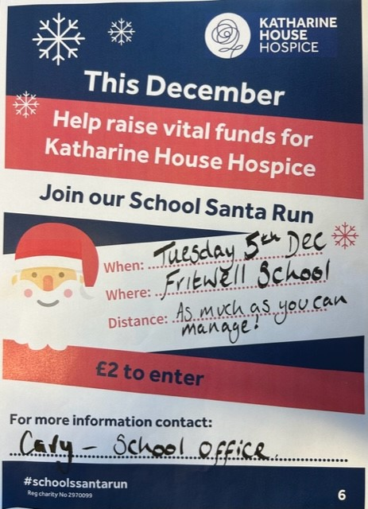
Santa Fun Run
Open to all, come along and enjoy the fun, you can run or walk as far as you like.
We will be collecting cash on the day so please send your child to school with their £2 donation on the day.
I have attached sponsorship form to the newsletter email if you wish to help raise even more money.

Slide 7
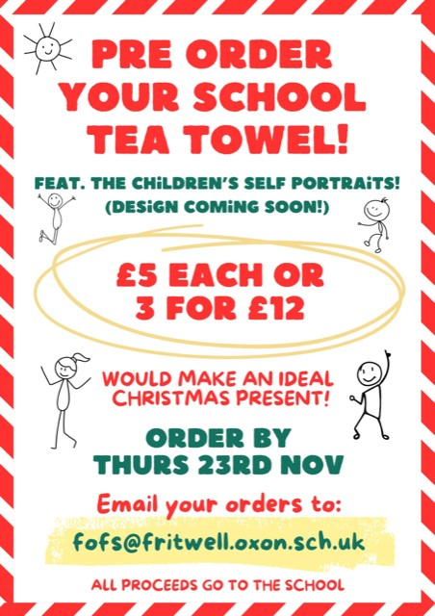
FoFs
Fireworks.
What. a. night! Thank you to everyone who came to the fireworks event last Sunday night we hope you had a great evening! 💥 It’s important to ‘remember remember’ this event is run entirely by volunteers (apart from the actual spectacular fireworks by Skyline) who give up their free time to put the event on for the School. Big thanks to the awesome FoFS team for all their hard work pulling this event together from all the planning weeks before, the set-up, work during the evening, and clear up! Many thanks to all the wider support team too including the brilliant parents and teachers who came to help on the night too! Team work makes the dream work 😃 Shout-outs to; Bakels who donated all the bread rolls, Wriggly Monkey for their time and donation, super generous parents for donations of the donuts, cookies and sweets, an awesome grandparent for the donation of the delicious sausages, a creative parent for their guess the gunpowder board and not forgetting our brilliant DJ James who also donated his time FOC!! Just amazing guys - thank you! Thank you also to our suppliers Wrightons for the burgers & BBQs! We’ll let you know the monies raised in the next newsletter. See you again next year? 💙 Thank you, the FOFS team.

