Slide 1
Foundation Stage: Term 3 Dangerous Dinosaurs

Slide 2
Our project this term is ‘Dangerous Dinosaurs’. This exciting project teaches children about the different animals that roamed Earth millions of years ago and how they are related to animals that live on Earth today.
Within the classroom, there will be plenty of opportunities for the children to be palaeontologists as they investigate a range of fossils inside our very own classroom laboratory. Outside the classroom, children will explore within our excavation area where they will use tools and work together in making thrilling discoveries.

Slide 3
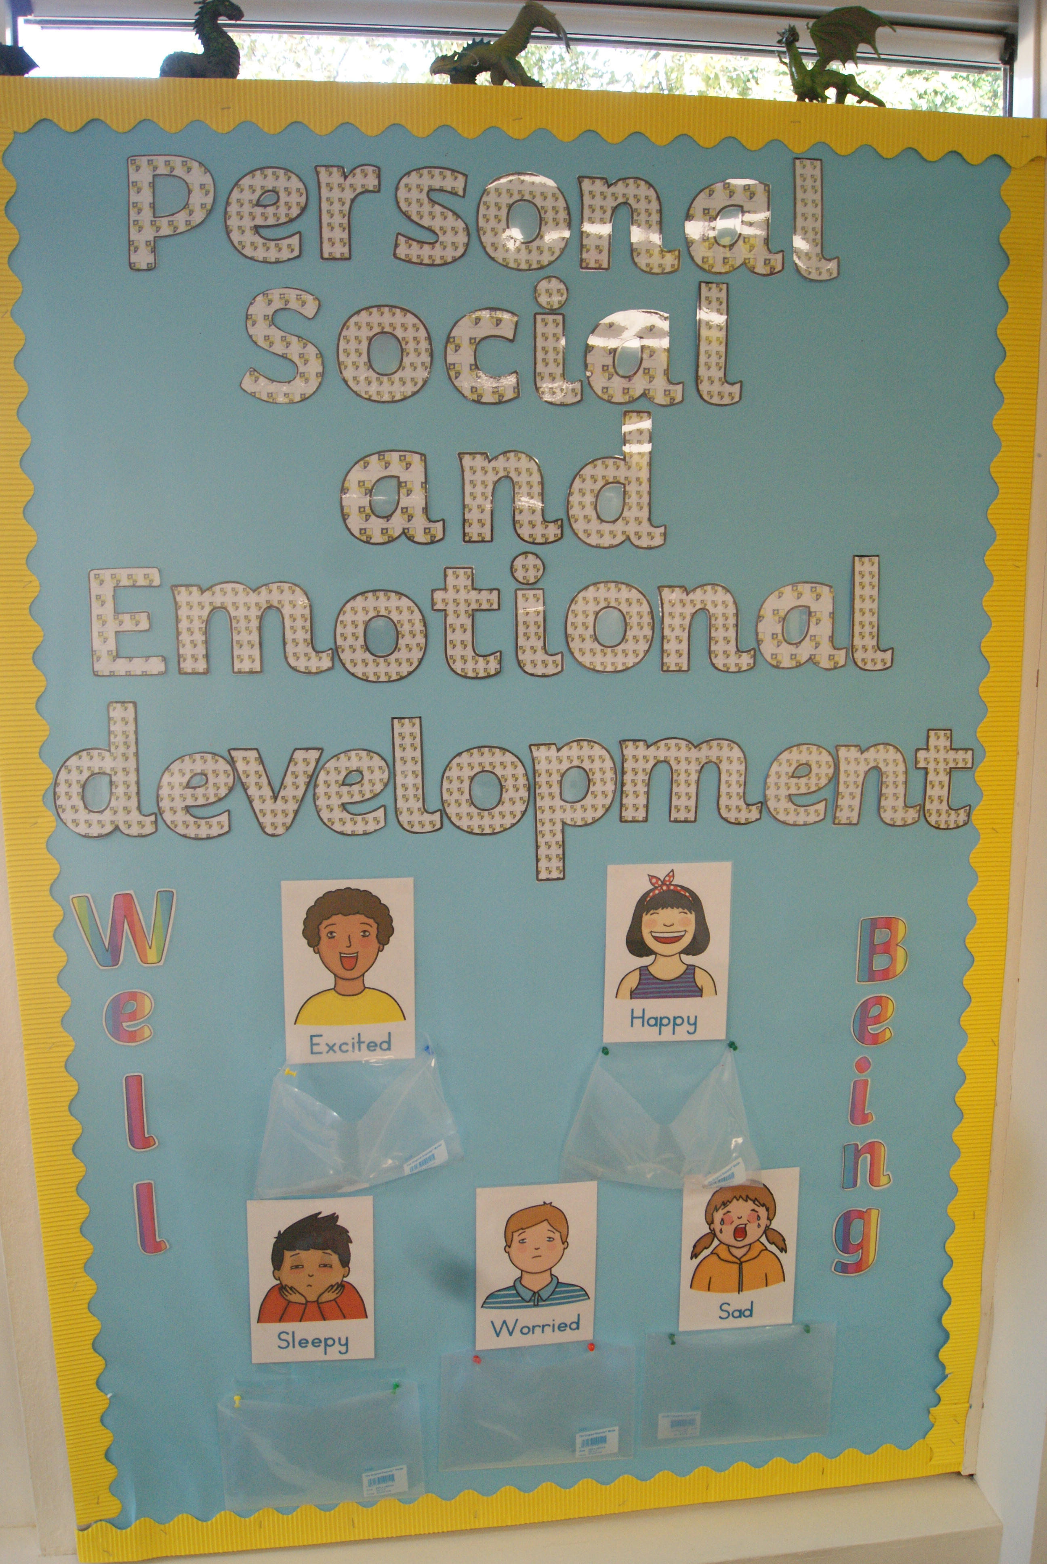
Personal, Social and Emotional Development.
The SCARF project this term is ‘Families and committed relationships’. Your child will describe themselves in positive terms; talking about their successes as we celebrate their learning & achievements. We will continue to be emotionally literate as we discuss how we are feeling about being back in the school environment. We will be looking at the features of dinosaurs especially their teeth where we will discuss the importance of dental hygiene as well as general hygiene. Your child will talk about dinosaurs being extinct and what their thoughts and feelings are regarding this. They will think about what the world be like today if dinosaurs still roamed our planet.

Slide 4
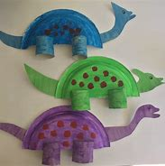
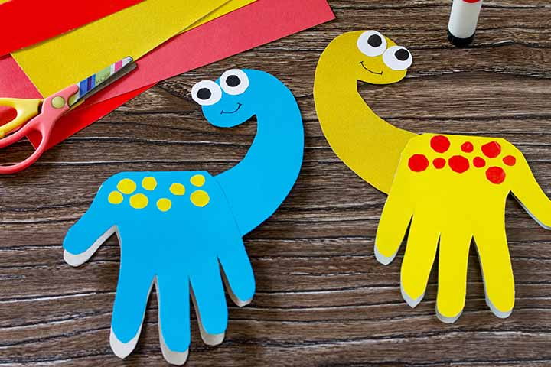
Literacy & Communication and Language
We will be focussing on the art of discussion this term as we talk about dinosaurs and what we like/dislike about them. Your child will talk confidently about their dinosaur design and will label their designs as well as labelling pictures of dinosaurs. As a class we will be thinking about instruction writing; how to make a Jurassic lava smoothie. Following this, your child will innovate the text to create their own instructions. We will be using a variety of writing techniques through this project as the children write letters, postcards, cards and labels. Your child will use vocabulary from the project in both their written work and in their discussions.

Slide 5
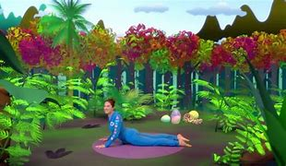
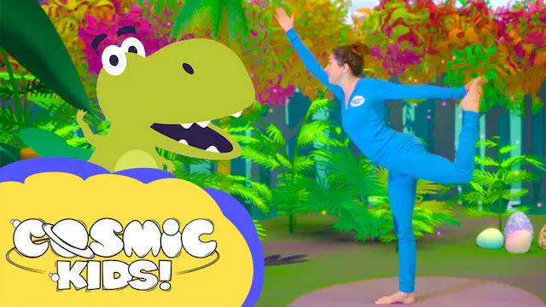
Physical Development
This term we will be thinking about how we look after ourselves physically. Your child will think about and discuss the effects that activity has on their body. In PE, your child will move their body in different ways and in varying speeds as they pretend to be dinosaurs. The children will move rhythmically as they create and showcase a dinosaur dance.

Slide 6
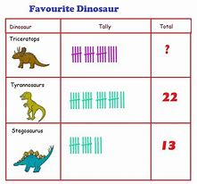
Mathematics
Throughout this term your child will develop their ability to subitise up to five and will learn about bar charts and pictograms as they collect and record data about dinosaurs. You child will build on their knowledge of adding taking away terminology as they work together to solve Maths Stories. Your child will also learn number bonds to 10. Doubling and halving numbers up to 20 will take place.

Slide 7
Understanding the World
As a class, we will be looking closely at similarities, differences, patterns and change. We will go back in time to think about what the Earth was like when dinosaurs inhabited it and how it has changed over time to the present day. Your child will work in groups to retrieve information from iPads, using ICT equipment to take photographs and as a design tool. Your child will understand different celebrations such as ‘The Chinese New Year’. This is the year of ‘The Dragon’.

Slide 8
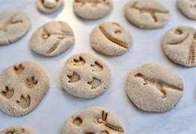
Expressive Art and Design
Your child will be working with a variety of mediums as they create differing forms of artwork. This term your child will; use the class ICT whiteboards to design their very own dinosaur, make and manipulate salt dough to create their own fossils and use their imagination as they think about and discuss what it would be like to be a dinosaur.

Slide 9
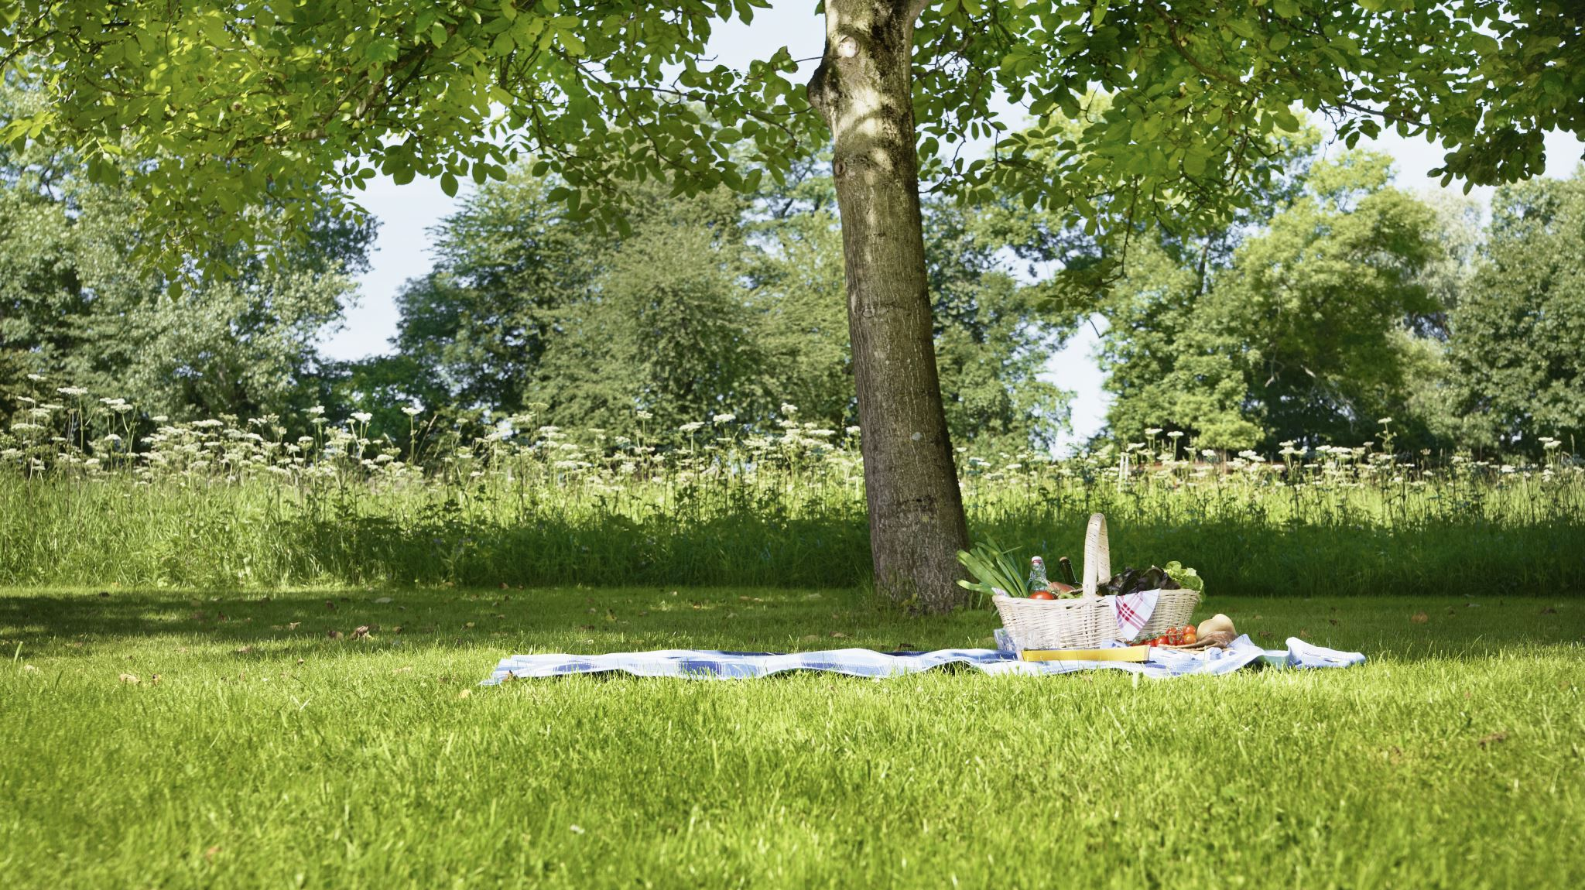
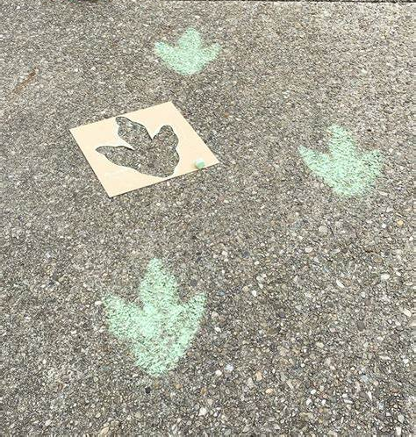
Outdoor Learning
Our outdoor learning will continue to be diverse and engaging as the children become paleontologists this term, finding and carefully extracting fossils from around our environment. They will investigate size and similarities as they find dinosaur footprints at Friwell. They will design and construct a dinosaur island to use in their imaginative play.

Slide 10
Useful Links
Oxford Owl
Oxford Owl is a fabulous resource for many subject areas and offers a very good reading range with many free resources.
Please follow this link: https://www.oxfordowl.co.uk/user/sign_up.html
which will allow you to create a home login with Oxford Owl. Once you have joined up and signed in, please follow this link: Free eBook library | Oxford Owl from Oxford University Press This will take you to the eBooks suitable for sharing at home.
Phonics play
A site packed with interactive phonics games which is great for child development within phonics
https://www.phonicsplay.co.uk/
Top Marks
Play these fun Maths Games for 3-5 year olds
https://www.topmarks.co.uk/maths-games/3-5-years/counting

